Slide 1
FIFA´s Global Injury and Illness Surveillance

Slide 2


Injury and illness surveillance

Slide 3
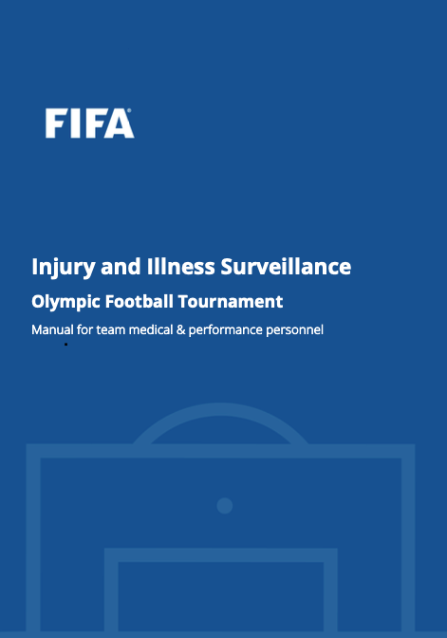





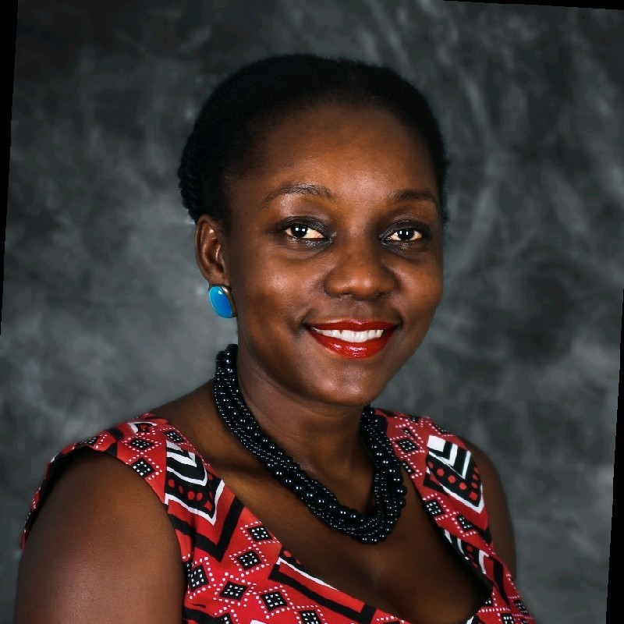

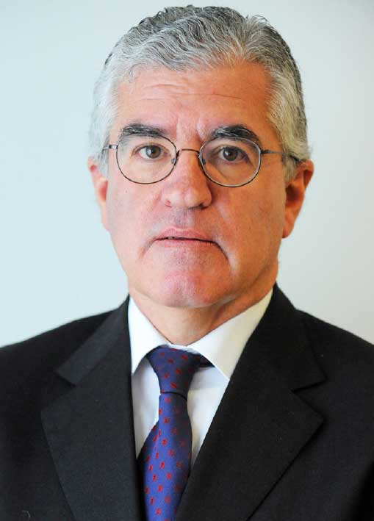
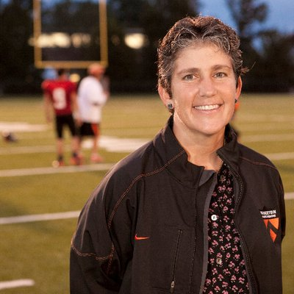
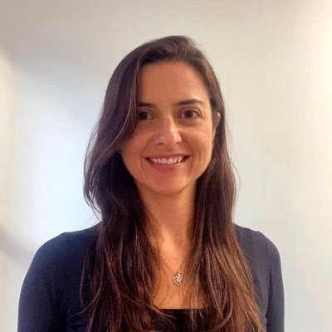
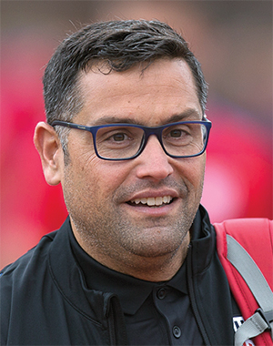

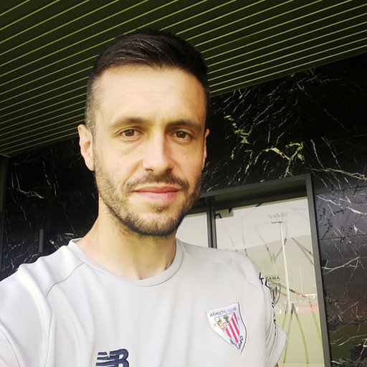
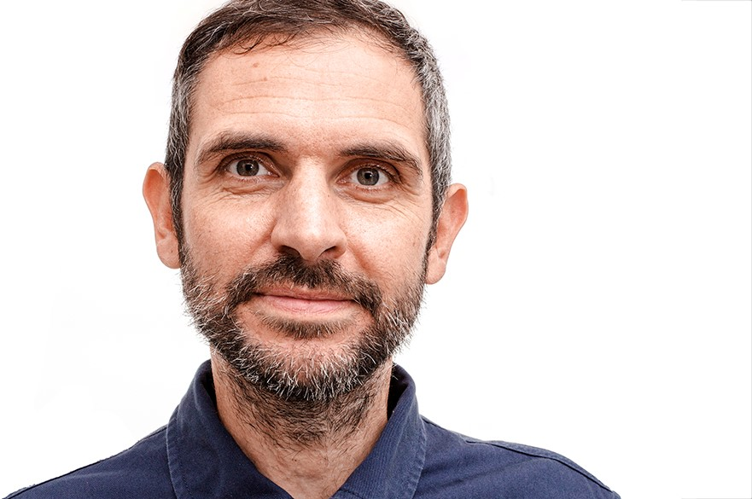
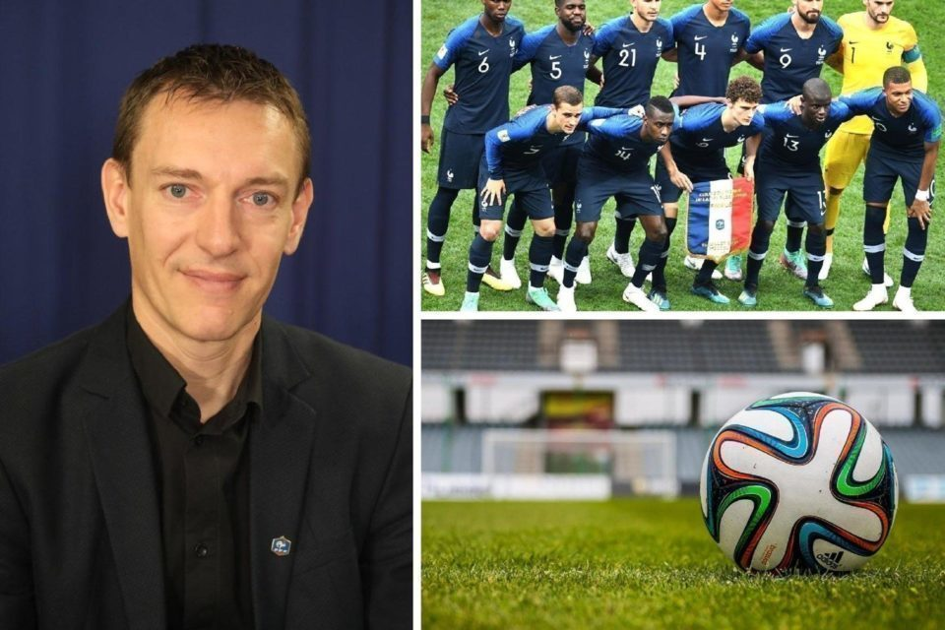




Surveillance manual
Surveillance officer

Slide 4
Team recruitment
If communication is difficult, we can use FIFA Match Doctors, IOC ++
Surveillance period has begun, ask late starters to register retrospectively

Slide 5
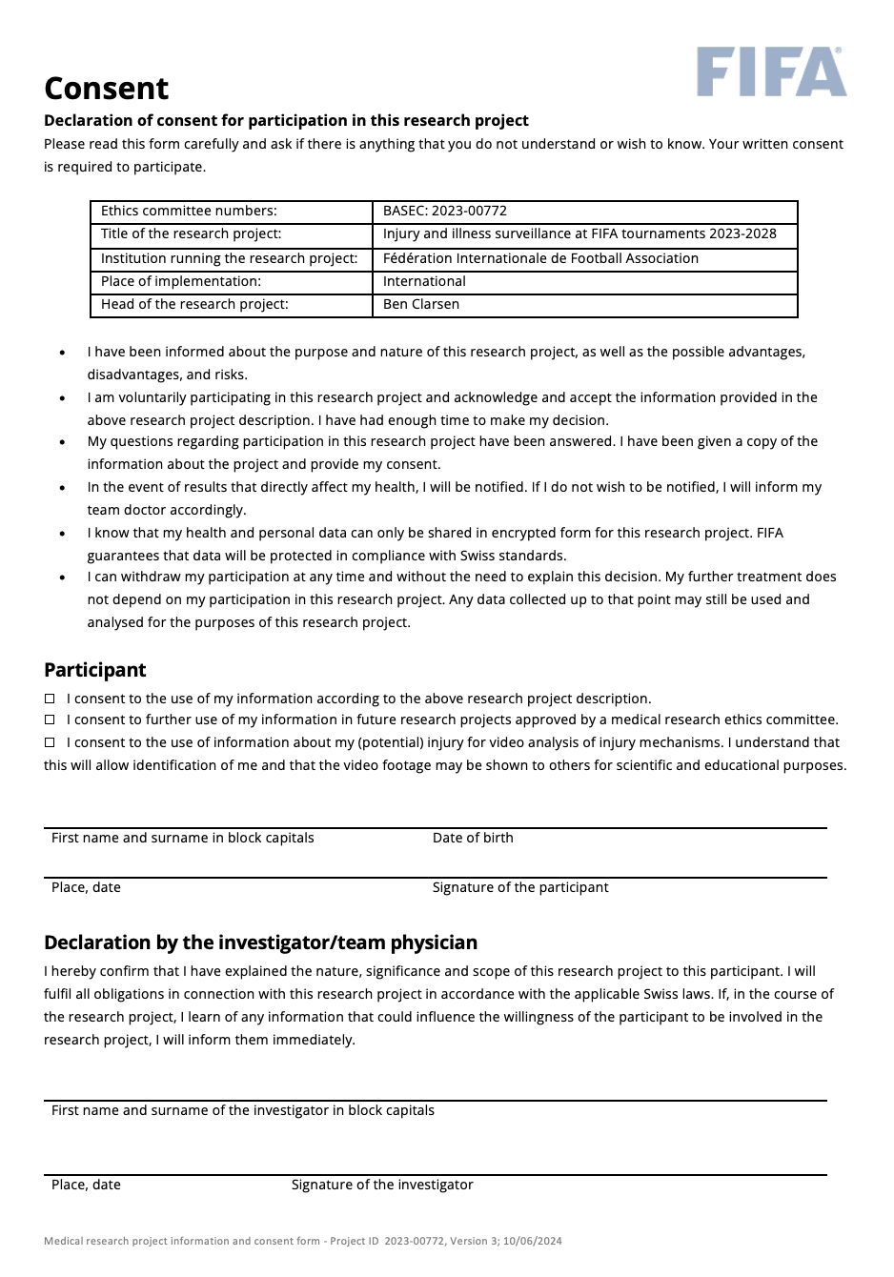
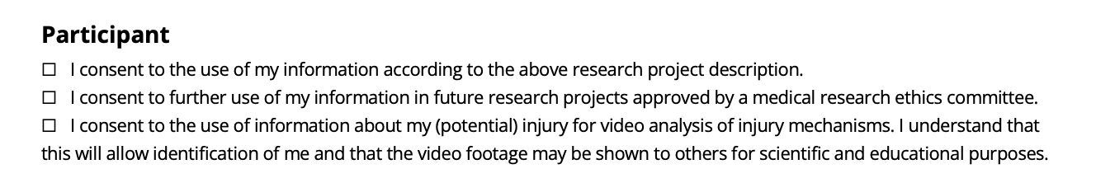
Player consent
Please explain the project to your players and ask them for consent to participation in the project
Signed consent forms can be given to FIFA Venue Medical Officers prior to first match, or scanned and emailed to ben.clarsen@fifa.org

Slide 6
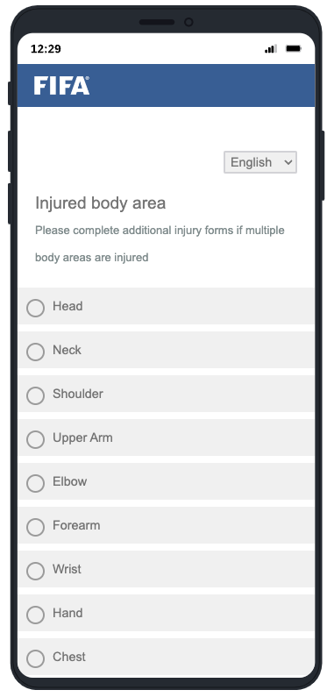

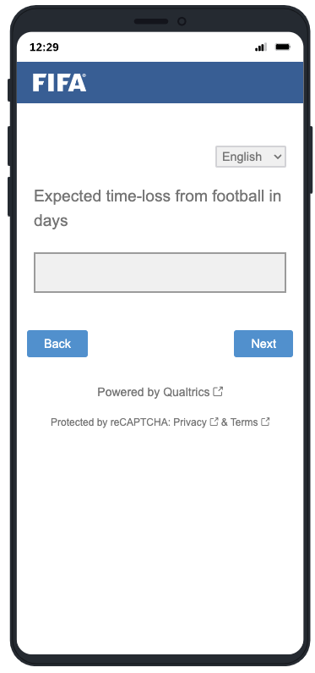


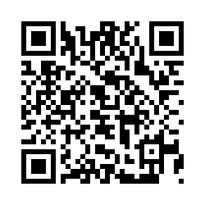
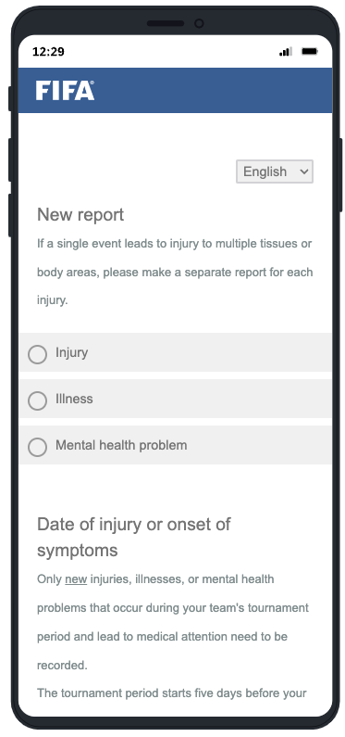
What should be recorded?
Injuries, illnesses, and mental health problems that occur during the tournament period and receive medical attention
Advice, assessment, or treatment from a medical doctor or other licensed medical professional (e.g. physio, AT)
On-field medical attention during matches
Routine physical preparation
(e.g. massage, taping)

Slide 7
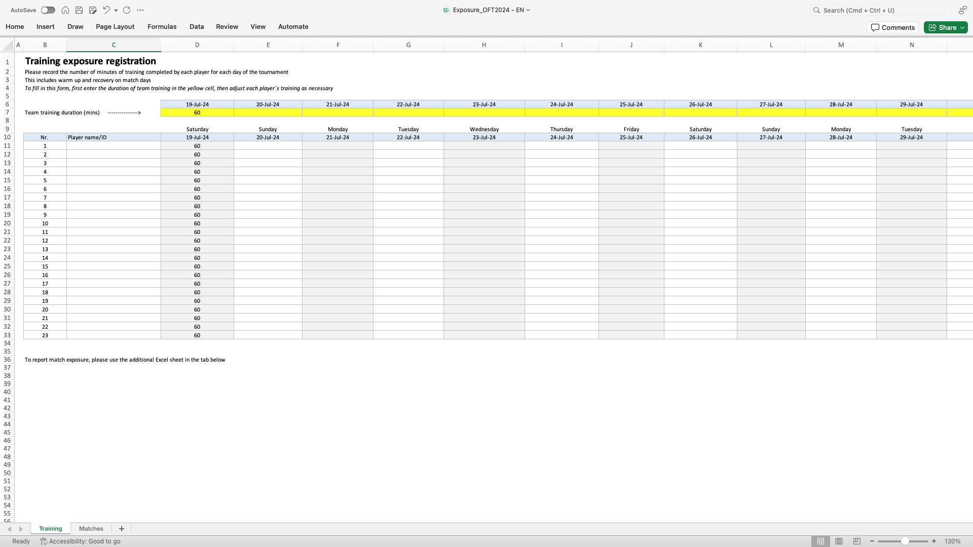
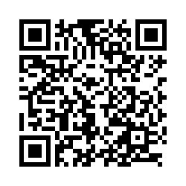
Exposure

Slide 8
Potential injury data
After each round, I will send overview of all incidents leading to on-pitch or off-pitch medical attention, or substitution
Potential for the paper – push hard for high-quality match injury data!

Slide 9

Data security & privacy
All data will be encrypted and stored on a secure FIFA server
Data management routines are compliant with the most stringent international data security laws (GDPR)
Only your surveillance officer and necessary FIFA medical staff have access to your data
Surveillance officers sign a non-disclosure agreement
No data on any individual players will be published without the player’s explicit consent
No team’s data will be identifiable in any publications

Slide 10
Data security & privacy
NDAs received?
Be careful with digital communication about sensitive information!

